Slide 1
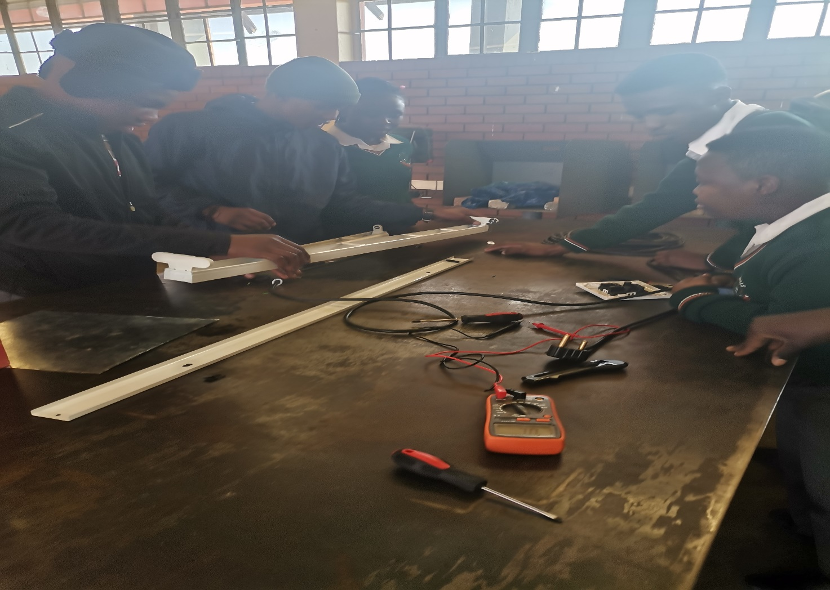
Electrical Maintenance
Video : Introduction to Electricity
https://youtu.be/CIv6vu9d73c?si=FR8BNwRlOTyICct1

Slide 2
Definition of electricity
- It is the flow electrical power or charge.
Types of Electricity
1.Current Electricity
- It the flow of electrons from one section of an electric circuit to another. e.g DC and AC
2. Static Electricity
- I t is the imbalance between the positive and negative charges in an object leads to a discharge of electric pulse.
Sources of electricity
1. Wind turbine
2. Tidal power
3. Alternating current
4. Solar power
5. Power station
6. Hydroelectricity
7. Nuclear power
8. Hydropower
Video : https://youtu.be/yB2ACJ46KZw?si=QhVN5iA8Wn9IlJot
Feedback : Activity

Slide 3
Kwa Thema Skills School
Subject : Maintenance Marks: 8
Grade : Year 1 Time : 30 mins
Date : / / 2024
Question:1
1.What is electricity?
1.1 ___________________________________
2. Name two main types of electricity.
2.1 __________________
2.2 __________________
3. Name five sources of electricity
3.1 __________________
3.2 __________________
3.3 __________________
3.4 __________________
3.5 __________________

Slide 4
Basic safety rules in Electricity.
1. Use SABS approved electrical wires or cords.
2. Do not use electrical tools with worn or damaged wires.
3. Do not touch electrical machines or tools with wet hands or barefoot.
4. Switch off and unplug after use all power hand tools.
5. Do not open the distribution box(DB) in the workshop.
6. Learners should not play with electrical sockets.
7. Do not pull the plugs by cord.
8. Do not attempt to repair electrical machines or tools.
9. No overloading of plugs.
10. Never put bare wires into sockets.
Video :
https://youtu.be/ggJo6m8NZtA?si=bmAN3zoHrYp5aEkj
Feedback: Activity

Slide 5
Kwa Thema Skills School
Subject : Maintenance Marks: 10
Grade : Year 1 Time : 30mins
Date : / / 2024
Question:1
1.Fill in the following sentences
1.1 Use ___________ approved electrical wires or cords.
1.2 Do not use electrical tools with worn or __________ wires.
1.3 Do not touch electrical machines or tools with wet ____________ or barefoot.
1.4 Switch ________ and unplug after use all power hand tools.
1.5 Do not open the ___________________ in the workshop.
1.6 Learners should not play with electrical ______________.
1.7 Do not pull the ___________ by cord.
1.8 Do not attempt to repair electrical machines or tools.
1.9 No _______________ of plugs.
1.10 Never put _________wires into sockets.
(distribution box: bare; overloading; SABS; sockets; repair; plugs; damaged; off; hands)

